Slide 1
Connect4 using Reinforcement Learning
Done by:
Arvind Raghavendran MDS202214 Sneha KK MDS202240
Sarvesh Bhandary MDS202253

Slide 2
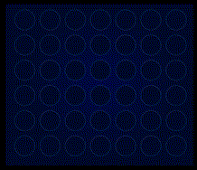
Introduction
- Connect Four: A well-known two-player strategy game
- Objective: Achieve a sequence of four colored discs in a row
- Gameplay: Players take turns selecting a slot to drop their discs

Slide 3
Strategies to Win
- Middle slots hold higher value due to increased potential for four-in-a-row.
- Assuming perfect play, literature [5] shows that:
Player 1 can always win by starting at center column.
Player 2 can always draw provided that Player 1 doesn’t start at the center.

Slide 4
Rules
- Vertical board with 6 rows and 7 columns, totaling 42 playable positions.
- Each player has 21 coin-like pieces in a different color, and they take turns dropping their pieces into a column on the board.
- Once a piece is dropped, it falls to the lowest available position in that column, and turns alternate between players.
- If a column is full, no more pieces can be played into it.
- The game ends when a player achieves a connect-four or when the board is full, resulting in a tie if no player has connected four pieces.

Slide 5
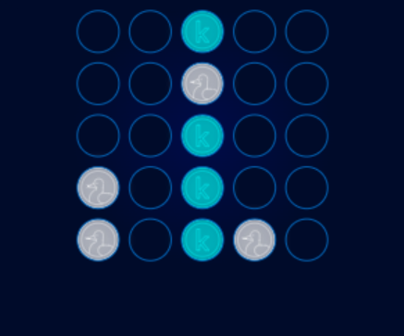
Action and State Space
- Actions Possible = 7 - C, where C is the number of full columns at the current state
- An estimated upper bound for possible states is 3^42, considering each position can be free/player one's piece/player two's piece.
- A lower bound, determined by a computer program, is around 4.5 trillion possible positions.

Slide 6
The need for Reinforcement Learning
- Connect Four's extensive branching factor restricts exhaustive search feasibility.
- Traditional algorithms covering the entire game tree incur high computational costs.
- Heuristic-based methods and Monte Carlo Tree Search are preferred alternatives.

Slide 7
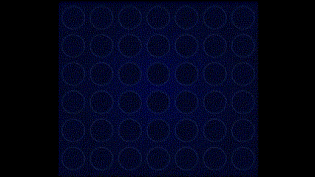
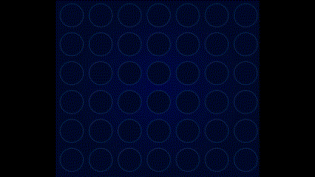
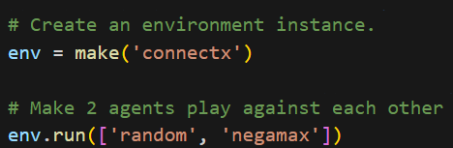
Kaggle Environment
Used to simulate ConnectX ⇒ m×n board, join X in a row to win
We are using the negamax algorithm as benchmark to test our agents
Player 1 Wins
Draw

Slide 8
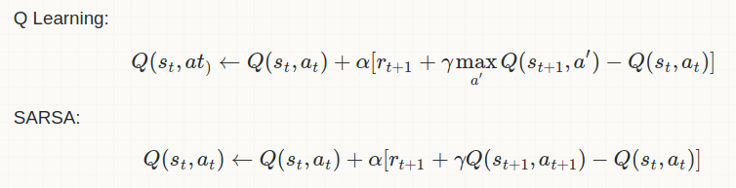
Traditional RL methods for Connect4
Monte Carlo methods
By sampling episodes as we cannot iterate over trillions of states
Updates based on states ,actions and rewards observed in sampled episodes
Q-learning and SARSA [1]
Epsilon greedy policies with an epsilon of 0.2
Learning rate = 0.1
Agent performs random moves if it encounters a new state

Slide 9
Rewards
Result | Reward obtained
Win | + 1
Lose | -1
Draw | - 0.5
Invalid action | -2
Intermediate states | 0
Rewards only at the end of an episode
cannot use experience replay

Slide 10
Model training and performance
SARSA trained with random agent : 1L episodes
Q-learning trained with random agent : 1L episodes
Q-learning trained with negamax : 10000 episodes
Performance vs random agent in 1000 games
Agent (training method) | Wins | Invalid moves/ draws | Losses
SARSA with random | 442 | 347 | 211
Q-learning with random | 597 | 238 | 165
Q-learning with negamax | 446 | 243 | 211

Slide 11
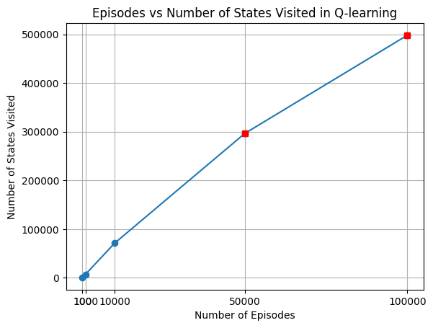
Are we seeing enough?
How much of the 4.5 Trillion states are we visiting?
1L episodes : each episode is a maximum of 42 states: 42L states in maximum
5L states is approximately 0.00001 percent: many actions are random

Slide 12
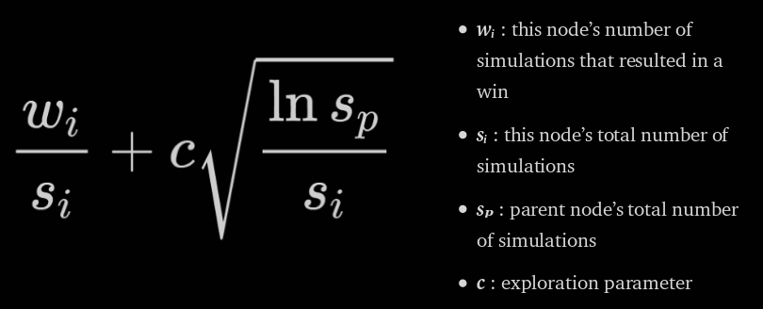
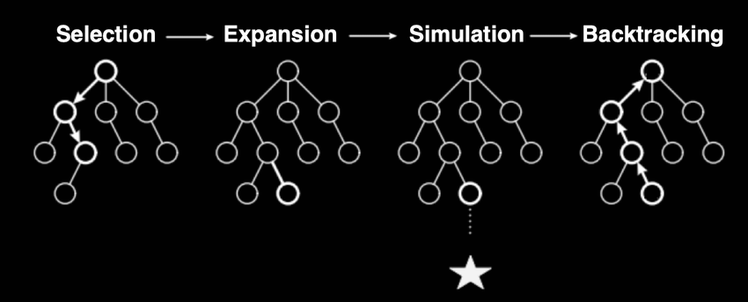
Monte Carlo Tree Search (MCTS)
Uses Upper Confidence Bound (UCB) scores given by
Select leaf nodes with highest UCB score [3]
Expand and simulate episodes to obtain UCB scores of new leaf nodes
Backtrack along the path and update UCB scores for leaf nodes

Slide 13
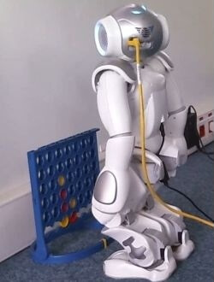
Training Connect4 bot using Deep RL
Model:
Input: Current state
Output: Estimated Q values for every action
Loss functions:
Least squares (Predicted and Target Q values) [2]
Mean Absolute Error
Architectures:
Simple FCNN
Completely trainable CNN
Partially trainable CNN

Slide 14

Loss function
Parameters shared across states
Strategies get refined for all states simultaneously
Learning without needing to visit every state

Slide 15
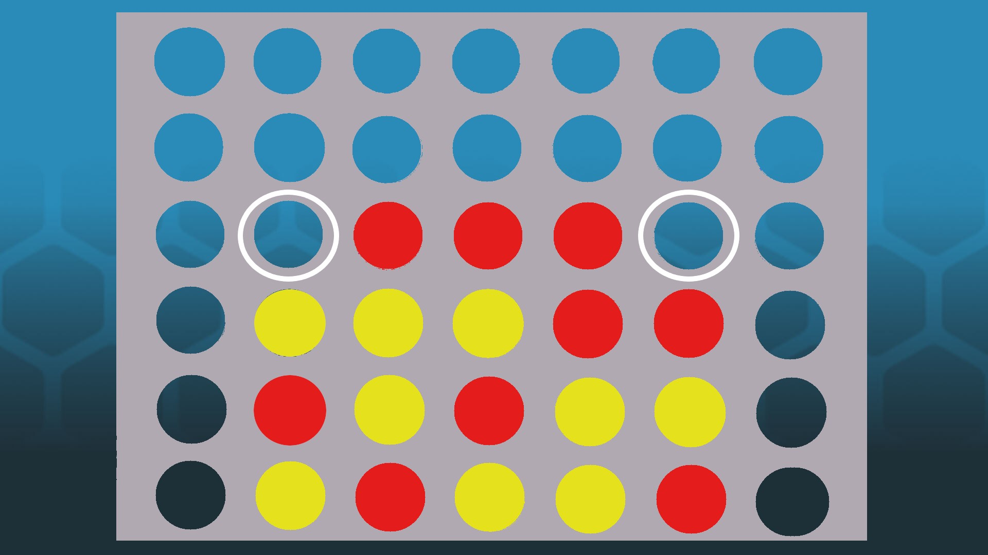
CNN based architectures
Kernels capture information regarding disc/token configuration
Exploits the grid nature of the game
Having few fixed kernels can identify potentially immediate win/lose conditions
Merging CNN and dense layers could help the model recognize different token configurations across different regions

Slide 16
Further Works
Explore reward systems with potentially integrating intermediate rewards
Experiment with more NN architectures, could try different fixed kernels
Use advanced MCTS implementation for quickly obtaining optimal strategies.
3D and larger board sizes version of Connect-4.
Investigating strategies that prioritize sequences of actions which lead to guaranteed wins rather than simply looking for more win possibilities

Slide 17
Work Split
Arvind: Explored different environments and available literature for training effective algorithms
Sneha: Implemented traditional RL algorithms like SARSA, Q-Learning etc. and demonstrated the large state space issue
Sarvesh: Formulated deep RL approaches using FCNNs and CNNs and explored MCTS methods

Slide 18
Bibliography
[1] Reinforcement Learning for Connect Four
[2] Deep Reinforcement Learning: An Introduction
[3] Applying Monte Carlo Tree Search to a game of Connect 4
[4] Multi-agent reinforcement learning in two-player zero-sum games
[5] The Game is Solved: White Wins

